Slide 1

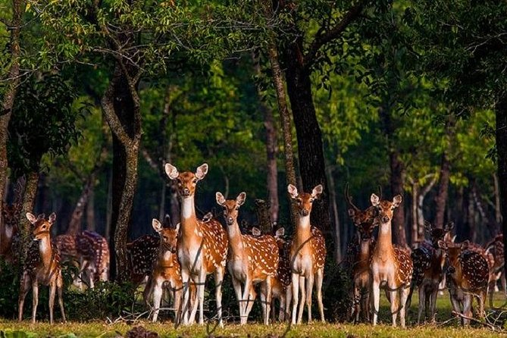
Hazrat ali
Roll 07
Batch :34

Slide 2

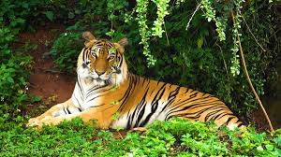
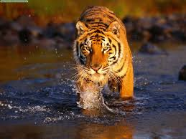
Bengal tiger
Scientific name: Panthera tigris tigris

Slide 3
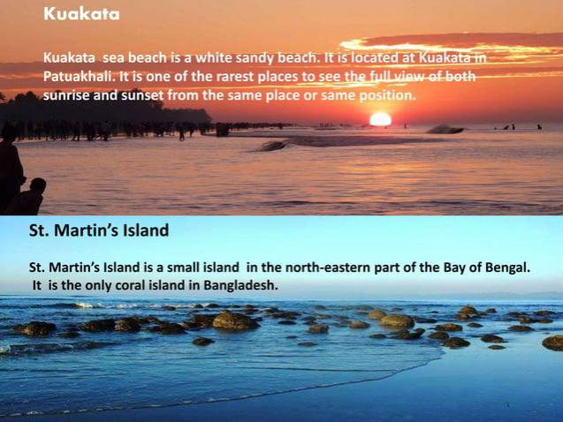
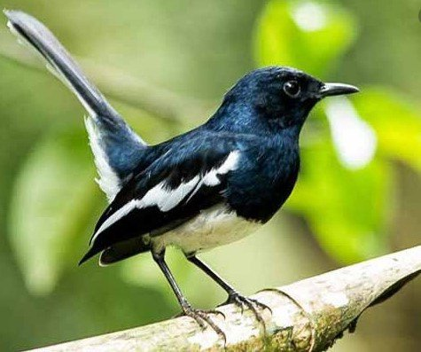
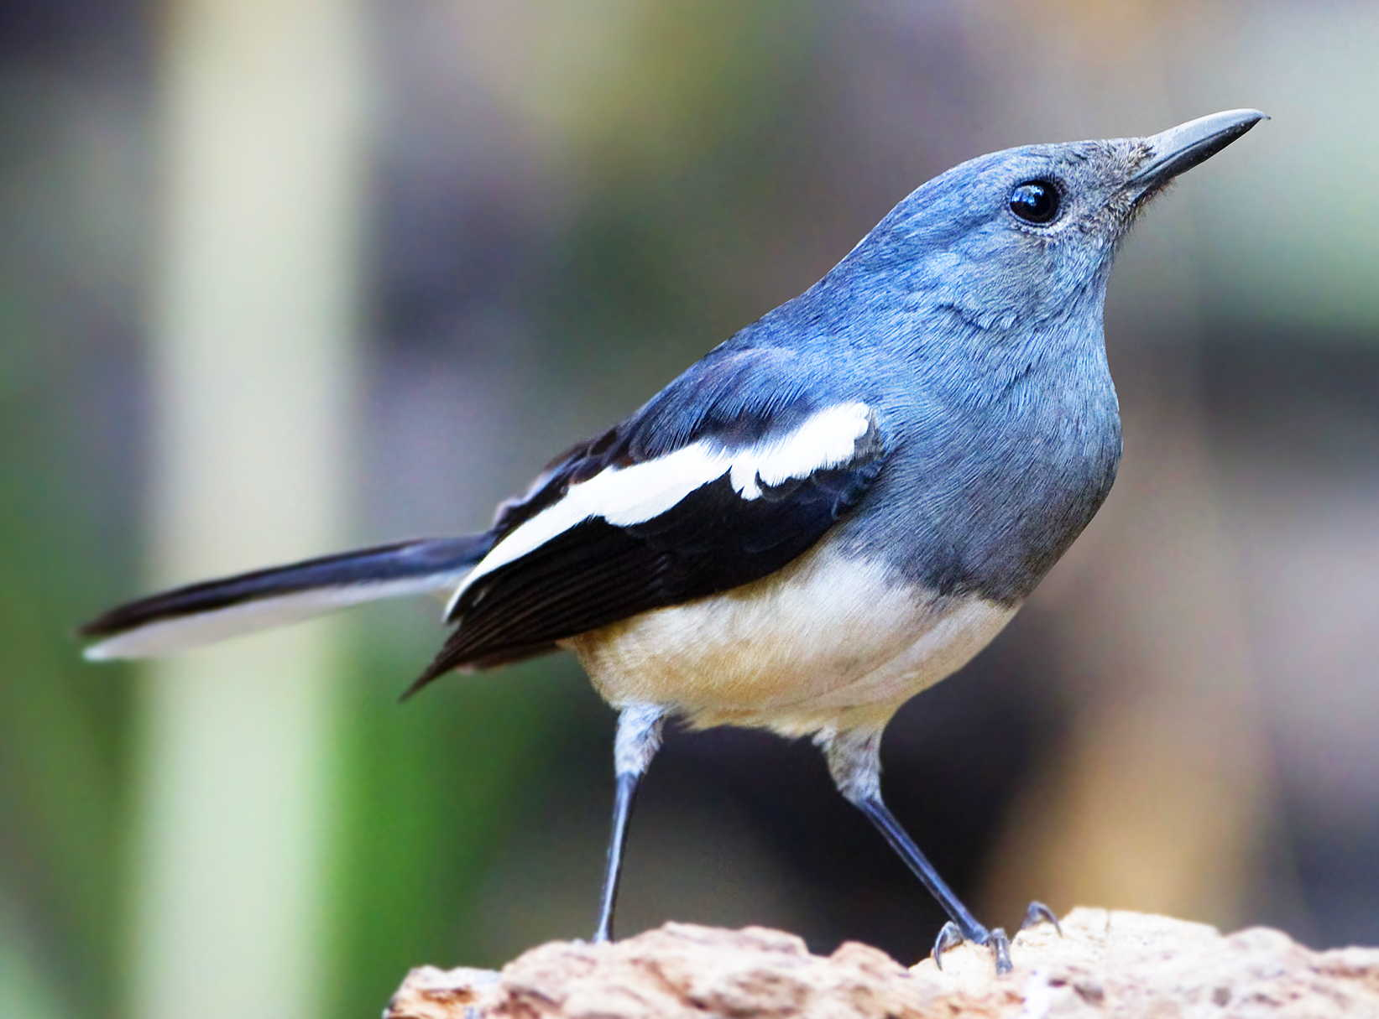
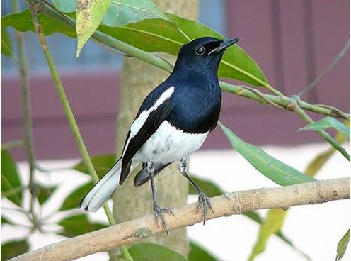

Slide 4



Slide 5
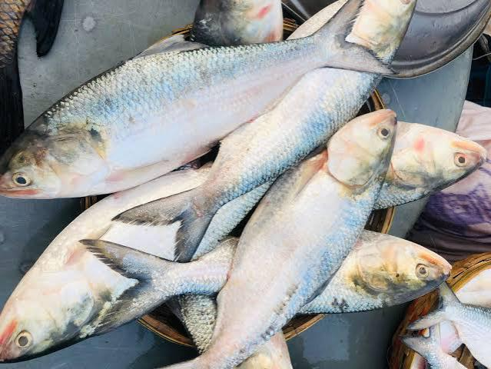
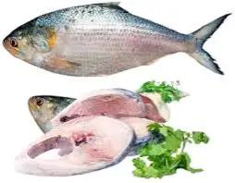
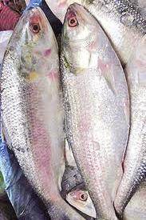
Ilish
Scientific name: Tenualosa ilisha

Slide 6
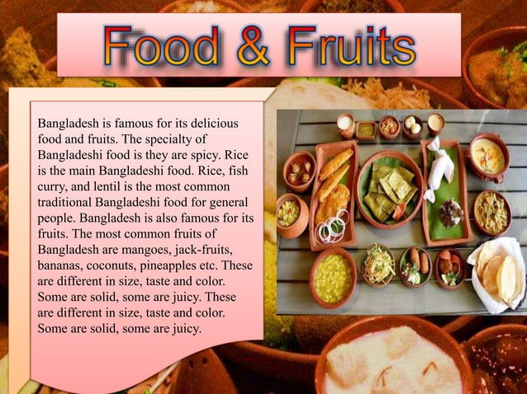
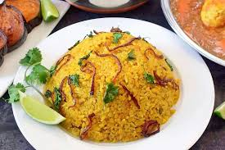

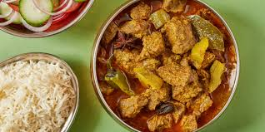

Slide 7
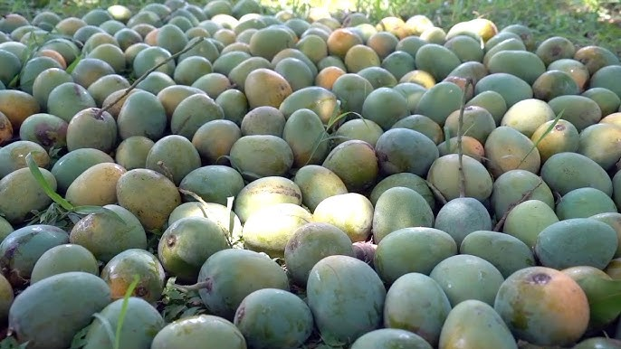
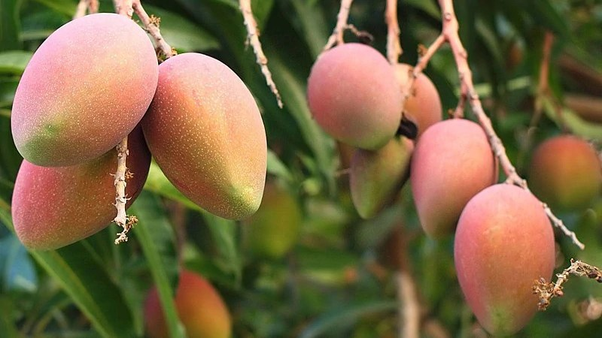
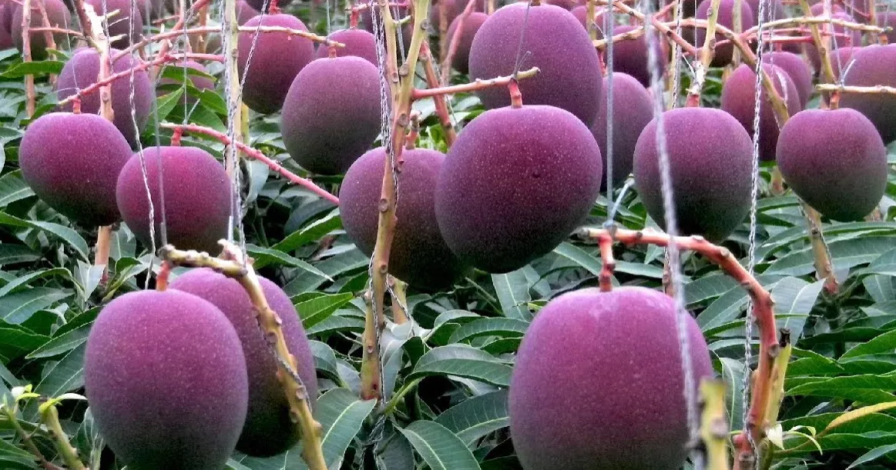
Mango
The main mango growing regions are around Rajshahi, Chapainawabganj, Nawabganj, and Dinajpur. The better varieties of mangoes have exotic names like Fazlee, Langda, Gopalbogh, Himsagar, Khirsapat, Ashhwina, Khisanbogh, Kuapahadi, Lata Bombai, Foria, Bombai, Kohitoor, Laksmanbhog, Mohanbhog, Misribhog etc

Slide 8
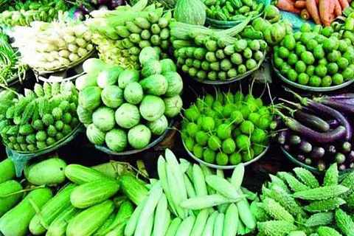
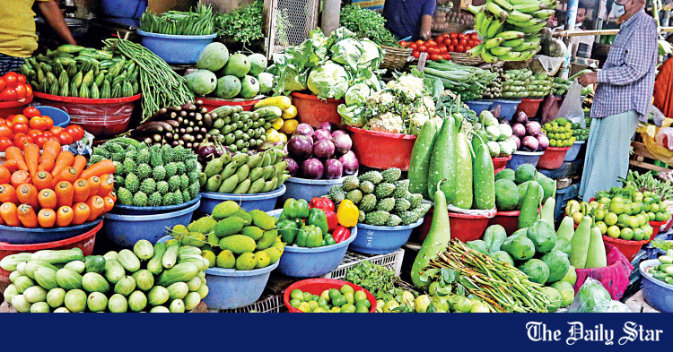
Vegetable
Vegetable any herbaceous plant whose fruit, seeds, roots, tubers, bulbs, leaves etc are used as food. Nearly 100 different types of vegetable comprising both local and exotic type are grown in Bangladesh (table). Vegetable is important for nutritional, financial, and food security in Bangladesh.

Slide 9





bangladeshi cricket

Slide 10


